Slide 1


NOSQL DATABASE
Dept of ISE
Subject code : 21CS745
By:
Prof. Supriya C
Assistant Professor
Department of ISE
Acharya Institute Of Technology

Slide 2
Distribution Models
Single Server
Sharding
Master-Slave Replication
Peer-to-Peer Replication
Combining Sharding and Replication
Consistency
Update Consistency
Read Consistency
Relaxing Consistency
The CAP Theorem
Relaxing Durability, Quorums.
Version Stamps
Business and System Transactions
Version Stamps on Multiple Node
MODULE 2
Dept of ISE

Slide 3
Distribution Models
As said, the primary driver of interest in NoSQL has been its ability to run databases on a large cluster
In particular, aggregate orientation fits well with scaling out because the aggregate is a natural unit to use for distribution
Depending on the distribution model, we can get a data store that will give us the ability to handle larger quantities of data
There are two paths to data distribution: Replication and Sharding.
Replication takes the same data and copies it over multiple nodes. Sharding puts different data on different nodes.
Let us now have a look to various models for data distribution
Sharding
Master-slave replication
Peer-to-peer replication
Dept of ISE

Slide 4
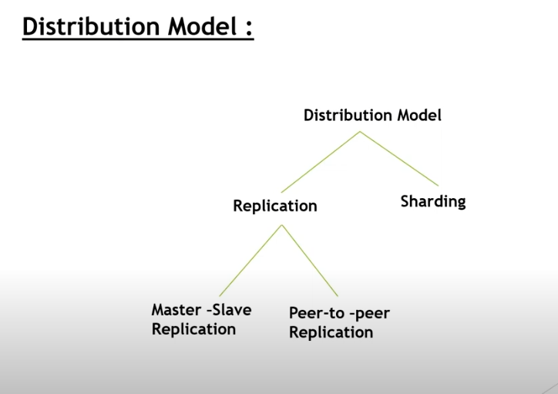
Dept of ISE

Slide 5
Single Server
Run the database on a single machine that handles all the reads and writes to the data store.
Eliminates complexities
Easy for operational people
Graph database
Dept of ISE

Slide 6
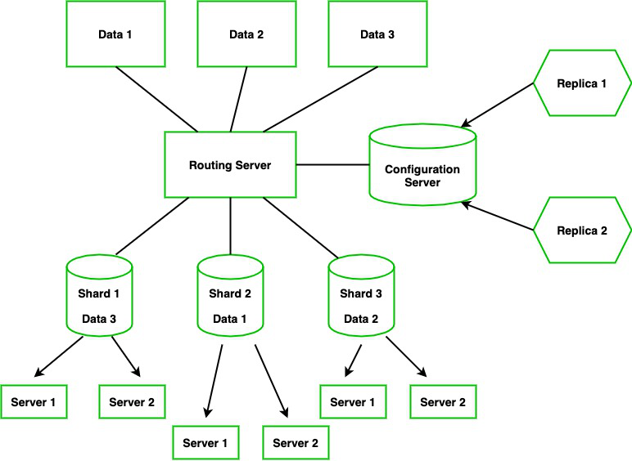
Sharding
Often, a busy data store is busy because different people are accessing different parts of the dataset. In these circumstances we can support horizontal scalability by putting different parts of the data onto different servers. This technique is called Sharding.
Dept of ISE

Slide 7
Sharding - Working Methodology
Sharding determines the problem with horizontal scaling.
It breaks the system dataset and store it over multiple servers, adding new servers to increase the volume as needed.
Let say we have Data 1, Data 2, and Data 3 this will be going to the routing server which will route the data (i.e, Different Data will go to a particular Shard ). Each Shard holds some pieces of data.
Here the configuration server will hold the metadata and it will configure the routing server to integrate the particular data to a shard however configure server is the MongoDB instance if it goes down then the entire server will go down, So it again has Replica Configure database.
Dept of ISE

Slide 8
Advantages of Sharding
Sharding adds more server to a data field automatically adjust data loads across various servers.
The number of operations each shard manage got reduced.
It also increases the write capacity by splitting the write load over multiple instances.
It gives high availability due to the deployment of replica servers for shard and config.
Total capacity will get increased by adding multiple shards.
Dept of ISE

Slide 9
Disadvantages of Sharding
Sharding however does little to improve resilience when used alone: Although the data is on different nodes, a node failure makes that shards data unavailable just as surely as it does for a single-server solution.
Many NoSQL databases offer auto-sharding, where the database takes on the responsibility of allocating data to shards and ensuring that data access goes to the right shard
Dept of ISE

Slide 10
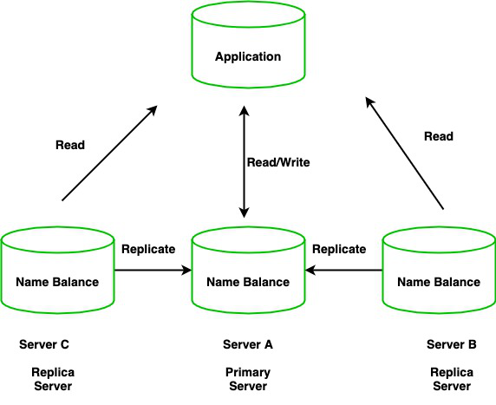
Replication
Replication is the method of duplication of data across multiple servers
For example, we have an application that reads and writes data to a database and says server A has a name and balance which will be copied/replicated to two other servers in two different locations.
Dept of ISE

Slide 11
Advantages of Replication
High Availability of data disasters recovery
No downtime for maintenance ( like backups index rebuilds and compaction)
Read Scaling (Extra copies to read from)
Dept of ISE

Slide 12
Key features of Replication
Replica sets are the clusters of N different nodes that maintain the same copy of the data set.
The primary server receives all write operations and record all the changes to the data i.e, oplog.
The secondary members then copy and apply these changes in an asynchronous process.
All the secondary nodes are connected with the primary nodes. there is one heartbeat signal from the primary nodes. If the primary server goes down an eligible secondary will hold the new primary.
Dept of ISE
Replication involves creating multiple copies of the same data across different servers to ensure high availability and fault tolerance. In contrast, Sharding divides a dataset into smaller pieces and distributes them across multiple servers, enabling horizontal scaling and efficient management of large datasets.

Slide 13
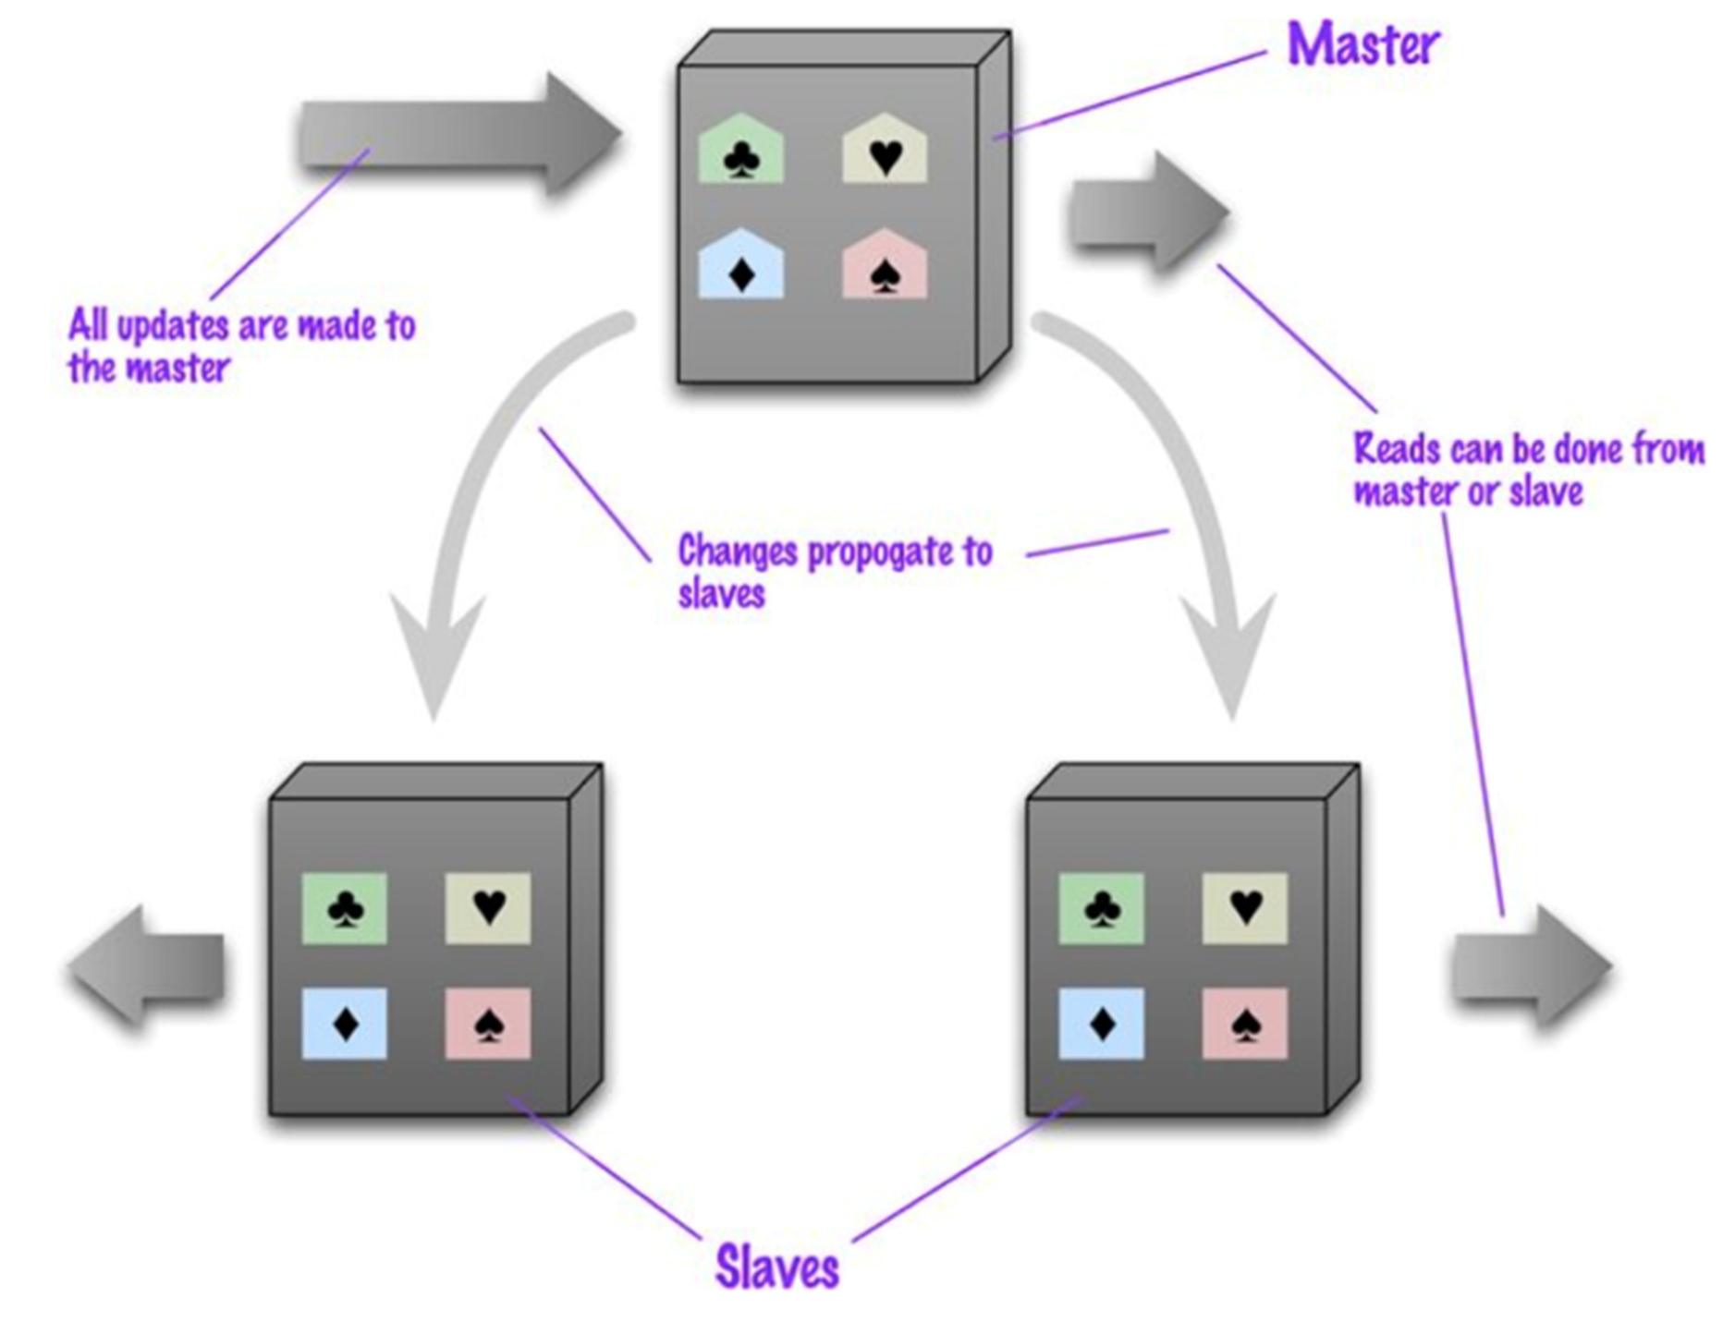
Master Slave Replication
With master-slave distribution, you replicate data across multiple nodes
One node is designated as the master, or primary, and is the authoritative source for the data, usually responsible for processing any updates to that data
The other nodes are slaves, or secondaries. A replication process synchronizes the slaves with the master
Dept of ISE

Slide 14
Challenges
Master-slave replication is most helpful for scaling when you have a read-intensive dataset, since read accesses can be on any node, but it isn’t such a good scheme for datasets with heavy write traffic, since all writes must be routed to the master and than propagated to the slaves.
Also, should the master fail, the slaves can still handle read requests (read resilience)
The failure of the master however eliminates the ability to handle writes until either the master is restored or a new master is appointed. Having slaves as replicates of the master does speed up recovery after a failure
The main drawback is the arising of possible inconsistency.
You have the danger that different clients, reading different slaves, will see different values because the changes haven’t all propagated to the slaves!
Dept of ISE

Slide 15
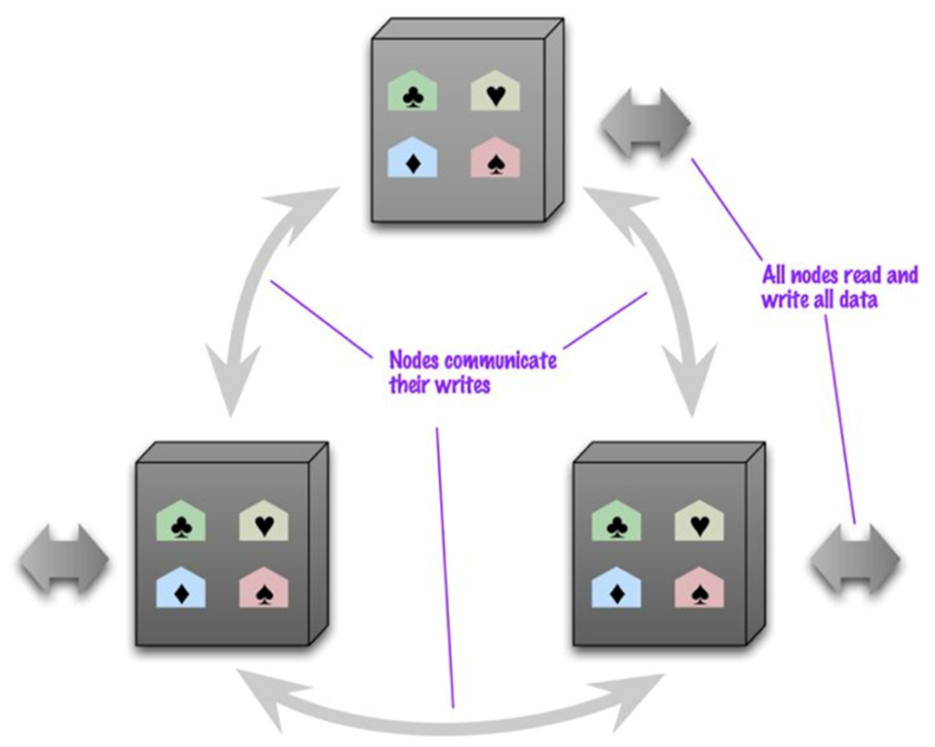
Peer - to - Peer Replication
Master-slave replication helps with read scalability but doesn’t help with scalability of writes. It provides resilience against failure of a slave, but not of a master
Peer-to-peer replication attacks these problems by not having a master. All the replicas have equal weight, they can all accept writes, and the loss of any of them does not prevent access to the data store
Dept of ISE

Slide 16
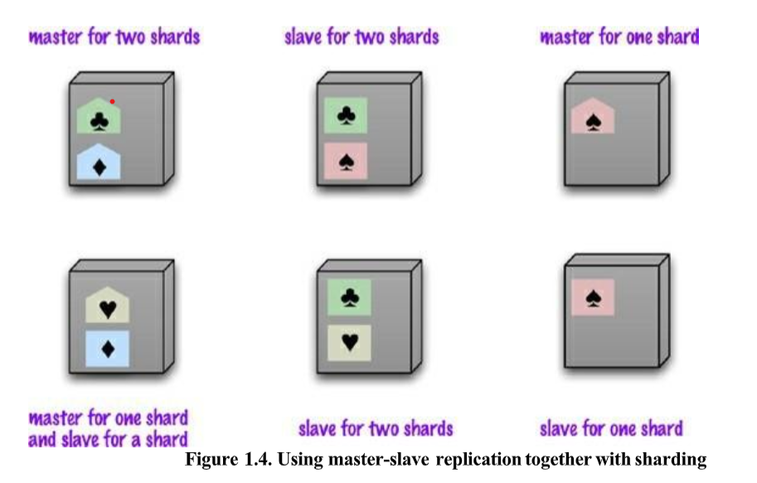
Combining Sharding and Replication
Replication and sharding are strategies that can be combined. If we use both master-slave replication and sharding (see Figure 1.4), this means that we have multiple masters, but each data item only has a single master.
Depending on our configuration, we may choose a node to be a master for some data and slaves for others, or you may dedicate nodes for master or slave duties.
Dept of ISE

Slide 17
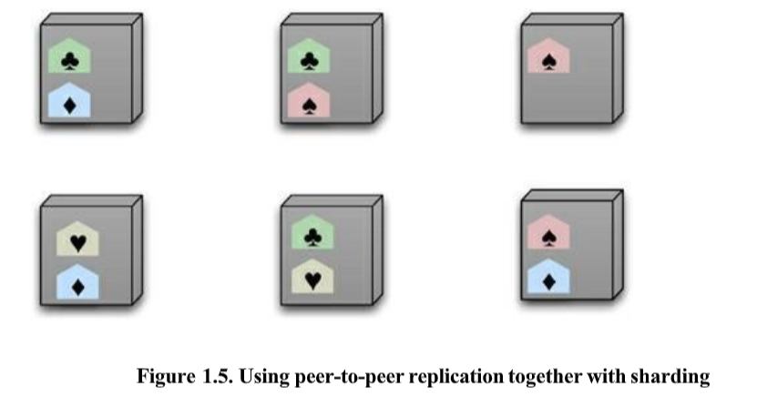
Using peer-to-peer replication and sharding is a common strategy for column-family databases.
In a scenario like this you might have tens or hundreds of nodes in a cluster with data sharded over them.
A good starting point for peer-to-peer replication is to have a replication factor of 3, so each shard is present on three nodes. Should a node fail, then the shards on that node will be built on the other nodes (see Figure 1.5).
Dept of ISE

Slide 18
Key Points
There are two styles of distributing data:
• Sharding distributes different data across multiple servers, so each server acts as
the single resource for a subset of data.
• Replication copies data across multiple servers, so each bit of data can be found in multiple places.
A system may use either or both techniques.
• Replication comes in two forms:
• Master-slave replication makes one node the authoritative copy that handles
writes while slaves synchronize with the master and may handle reads.
• Peer-to-peer replication allows writes to any node; the nodes coordinate to
synchronize their copies of the data.
Master-slave replication reduces the chance of update conflicts but peer-to-peer
replication avoids loading all writes onto a single point of failure.
Dept of ISE

Slide 19
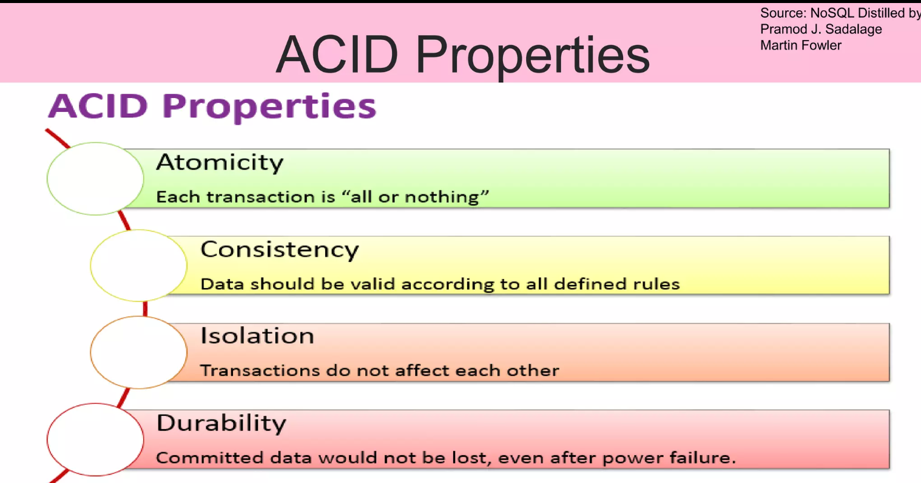
Chapter 5 : Consistency
One of the biggest changes from a centralized relational database to a cluster-oriented NoSQL database is in how we think about consistency. Relational databases try to exhibit strong consistency by avoiding all the various inconsistencies.
Informally: “every request receives the right response”.
In relational databases the above aim is achieved through the enforcement of so-called ACID properties to database transactions (strong consistency).
Dept of ISE

Slide 20
Update Consistency
We’ll begin by considering updating a telephone number. Coincidentally, Martin and Pramod are looking at the company website and notice that the phone number is out of date.
They both have update access, so they both go in at the same time to update the number. To make the example interesting, we’ll assume they update it slightly differently, because each uses a slightly different format.
This issue is called a write-write conflict: two people updating the same data item at the same time.
When the writes reach the server, the server will serialize them—decide to apply one, then the other.
A failure of consistency happens in this case because Pramod’s update was based on the state before Martin’s update, yet was applied after it.
Approaches for maintaining consistency in the face of concurrency are often described as pessimistic or optimistic.
Dept of ISE

Slide 21
Update Consistency - Approaches
A pessimistic approach works by preventing conflicts from occurring; an optimistic approach lets conflicts occur, but detects them and takes action to sort them out.
For update conflicts, the most common pessimistic approach is to have write locks, so that in order to change a value you need to acquire a lock, and the system ensures that only one client can get a lock at a time.
So Martin and Pramod would both attempt to acquire the write lock, but only Martin (the first one)would succeed. Pramod would then see the result of Martin’s write before deciding whether to make his own update.
A common optimistic approach is a conditional update where any client that does an update tests the value just before updating it to see if it’s changed since his last read. In this case, Martin’s update would succeed but Pramod’s would fail. The error would let Pramod know that he should look at the value again and decide whether to attempt a further update.
But if there’s more than one server, such as with peer-to-peer replication, then two nodes might apply the updates in a different order, resulting in a different value for the telephone number on each peer.
Dept of ISE

Slide 22
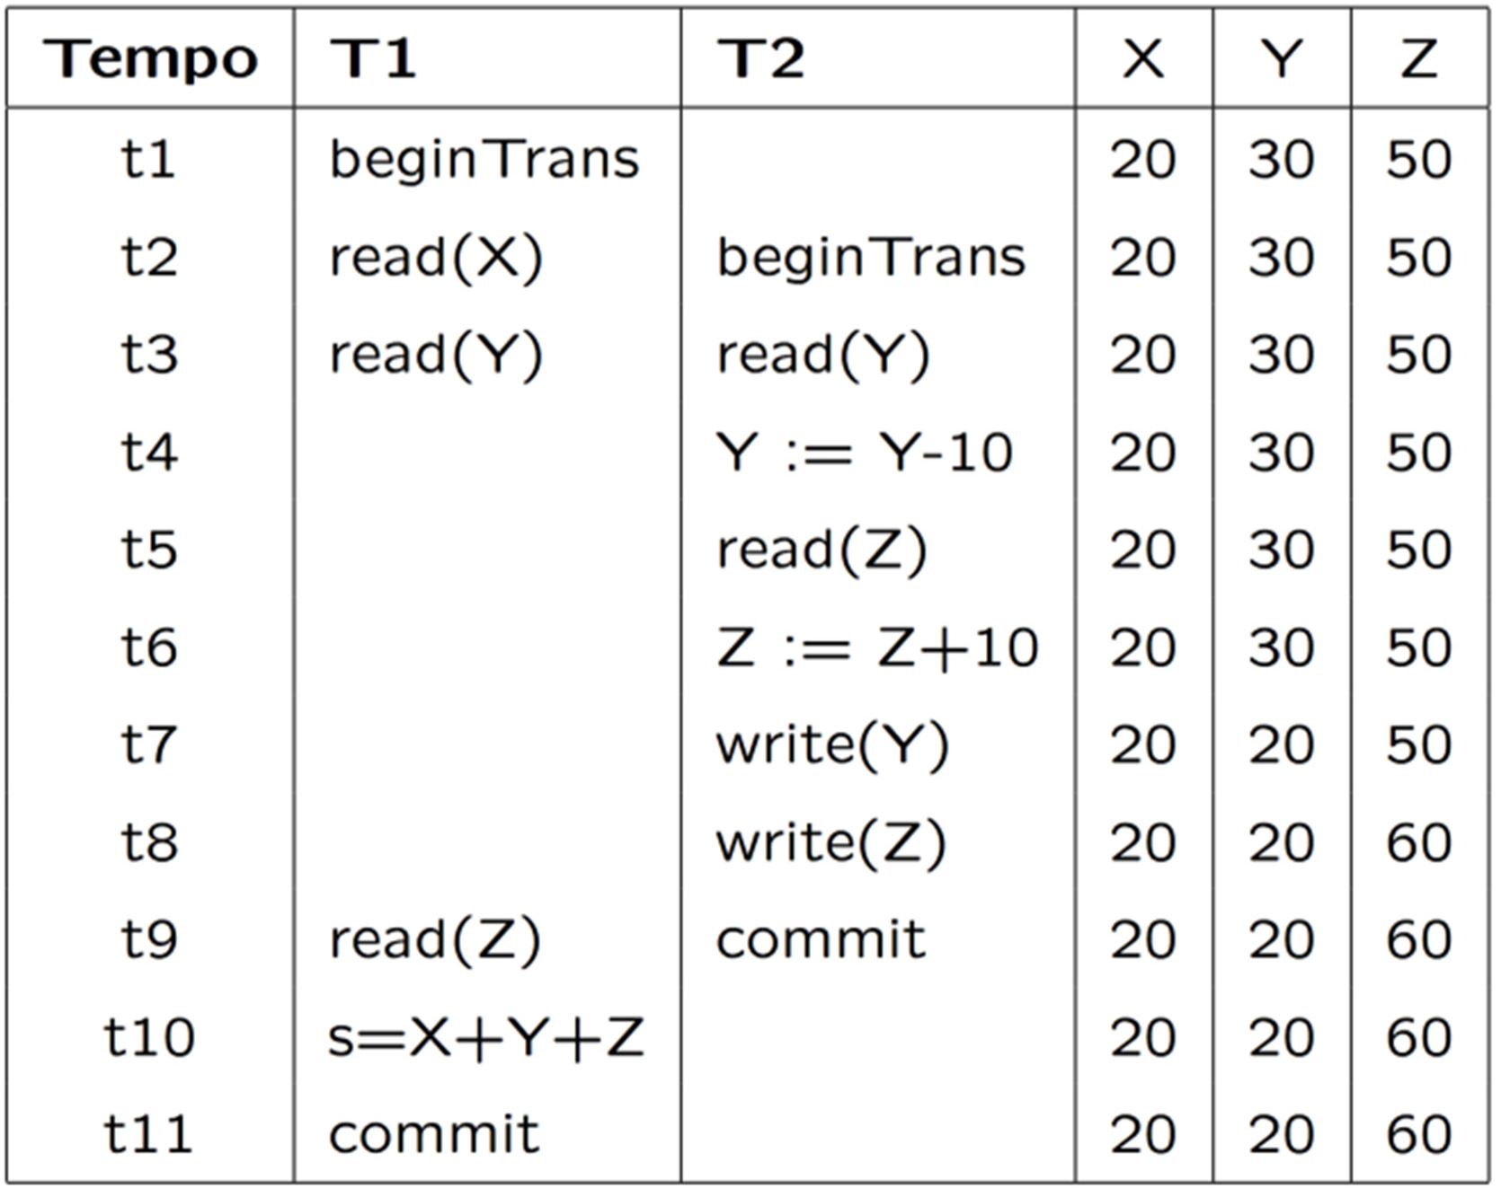
Update Consistency – With multiple server
When we talk about concurrency in distributed systems, they talk about sequential consistency—ensuring that all nodes apply operations in the same order.
Concurrent programming involves a fundamental tradeoff between safety (avoiding errors such as update conflicts) and liveness (responding quickly to clients).
Replication makes it much more likely to run into write-write conflicts. If different nodes have different copies of some data which can be independently updated, then you’ll get conflicts unless we take specific measures to avoid them.
In this example, we want to check whether X+Y+Z=100.
Dept of ISE
This kind of conflicts is also called inconsistent read. Avoiding them means ensuring logical consistency

Slide 23
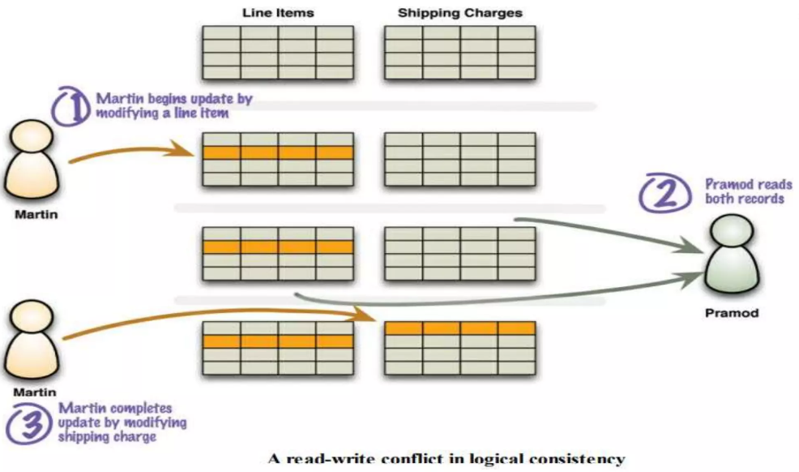
Read Consistency
Data store that maintains update consistency is one thing, but it doesn’t guarantee that readers of that data store will always get consistent responses to their requests.
Let’s imagine we have an order with line items and a shipping charge. The shipping charge is calculated based on the line items in the order. If we add a line item, we thus also need to recalculate and update the shipping charge.
In a relational database, the shipping charge and line items will be in separate tables.
Dept of ISE

Slide 24
Read Consistency
To avoid a logically inconsistent read-write conflict, relational databases support the notion of transactions. Providing Martin wraps his two writes in a transaction, the system guarantees that Pramod will either read both data items before the update or both after the update.
A common claim we hear is that NoSQL databases don’t support transactions and thus can’t be consistent.
Aggregate-oriented databases do support atomic updates, but only within a single aggregate but not between aggregates. In contrast, graph databases tend to support ACID transactions just the same as relational databases.
Since in NoSQL databases logical consistency is within an aggregate but not between aggregates, any update that affects multiple aggregates leaves open a time when clients could perform an inconsistent read.
A NoSQL system may have a quite short inconsistency window (e.g., Amazon’s documentation says that the inconsistency window for its SimpleDB service is usually less than a second)
Dept of ISE

Slide 25
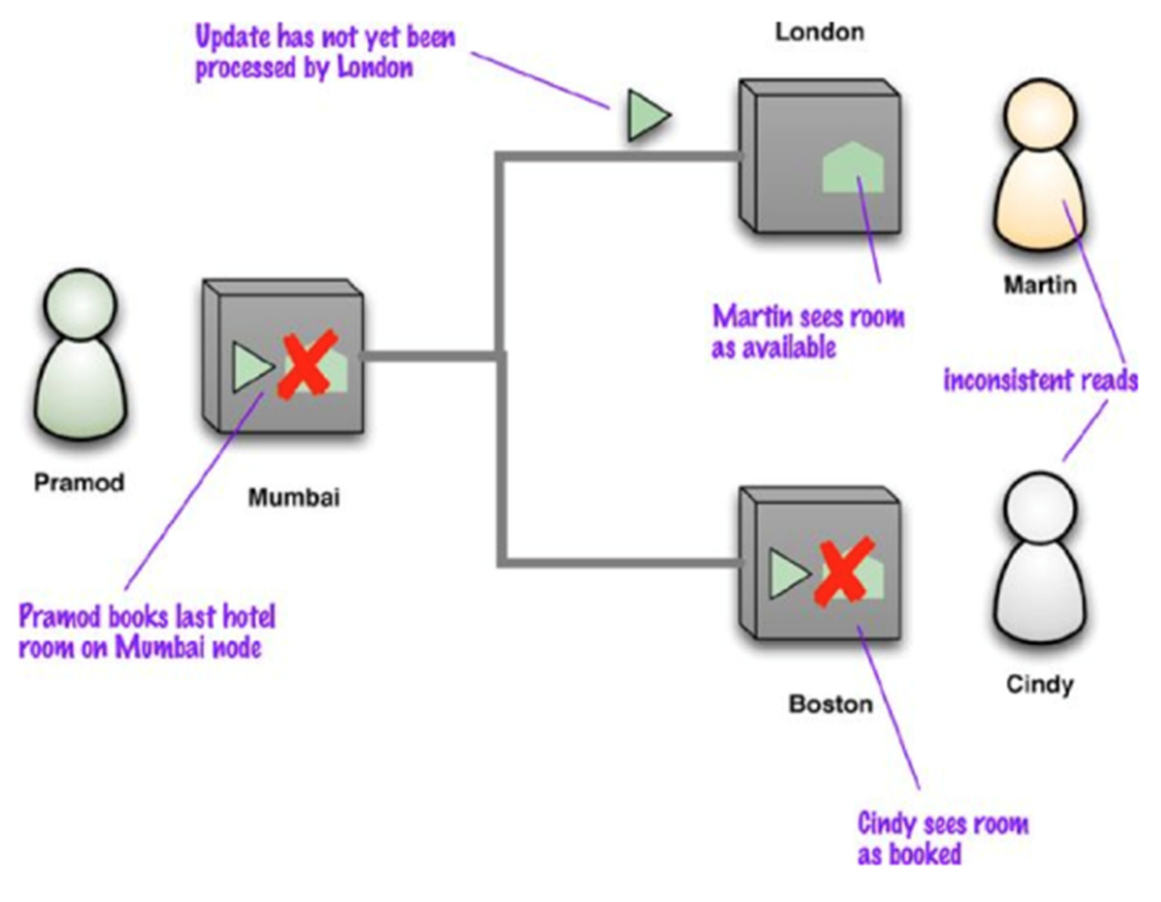
Replication Consistency
Replication consistency amounts to ensuring that the same data item has the same value when read from different replicas.
Example: Martin and Cindy, who are in London and Boston respectively, are on phone to book together an hotel room. At the same time, Pramod books the last room in that hotel at the Mumbai node and the Boston node shows the booking before the London one
Dept of ISE

Slide 26
Inconsistency Window
The presence of an inconsistency window means that different people will see different things at the same time.
If Martin and Cindy are looking at rooms while on a transatlantic call, it can cause confusion. It’s more common for users to act independently, and then this is not a problem.
But inconsistency windows can be particularly problematic when you get inconsistencies with yourself. Consider the example of posting comments on a blog entry.
Often, systems handle the load of such sites by running on a cluster and load-balancing incoming requests to different nodes
You may post a message using one node, then refresh your browser, but the refresh goes to a different node which hasn’t received your post yet—and it looks like your post was lost.
Session consistency guarantees read-your-writes consistency within a session: if the session ends for some reason, or the user access simultaneously the same system from different computers. He/she may lose the consistency.
Dept of ISE

Slide 27
Session Consistency - Techniques
There are a couple of techniques to guarantee session consistency.
sticky session: a session that’s tied to one node (this is also called session affinity). The downside is that sticky sessions reduce the ability of the load balancer to do its job.
using version stamps : ensuring that every interaction with the data store includes the latest version stamp seen by a session. The server node must then ensure that it has the updates that include that version stamp before responding to a request.
A version stamp is a field that changes every time the data in the database changes. When you read the data you keep a note of the version stamp, so that when you write data you can check to see if the version has changed.
Dept of ISE

Slide 28
Relaxing consistency
More in general, in distributed databases, consistency, and in particular isolation, is often relaxed for performance reasons in such a way that also conflicts typically avoided in a single-server setting (like WW conflicts) are somehow tolerated.
Indeed, concurrent programming involves a fundamental tradeoff between safety (avoiding errors such as WW conflicts) and liveness (responding quickly to clients)
Also, we notice that in the presence of more than one server, such as with peer-to-peer replication, serializability is complicated by the fact that different nodes might apply the updates in a different order. Often, when people talk about concurrency in distributed systems, they talk about sequential consistency— ensuring that all nodes apply operations in the same order.
Dept of ISE

Slide 29
Properties of shared data systems
Consistency
(informally) “every request receives the right response”
E.g. If I get my shopping list on Amazon I expect it contains all the previously selected items
It is essentially what discussed so far
Availability
(informally) “each request eventually receives a response”
E.g. eventually I access my shopping list
A bit more formally: if you can talk to a node in the cluster, it can read and write data.
tolerance to network Partitions
(informally) “servers can be partitioned into multiple groups that cannot communicate with one other”
A bit more formally: the cluster can survive communication
breakages that separate the cluster into multiple partitions unable to communicate one another
Dept of ISE

Slide 30
The CAP Theorem
When we try to have a cluster to be really tolerant to network partitions, the CAP theorem comes into play
“Of three properties of shared-data systems (Consistency, Availability and tolerance to network Partitions) only two can be achieved at any given moment in time.”
Dept of ISE
2000: Eric Brewer, PODC conference keynote
2002: Seth Gilbert and Nancy Lynch, ACM SIGACT News 33(2)

Slide 31
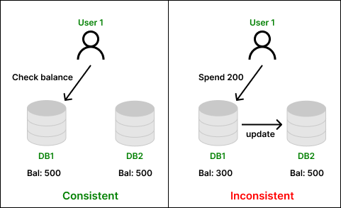
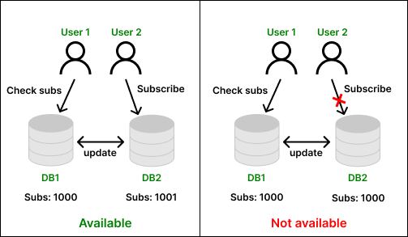
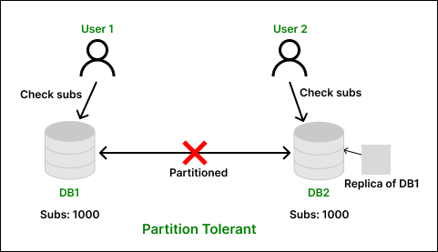
Consistency Availability
Dept of ISE
Partition Tolerance

Slide 32
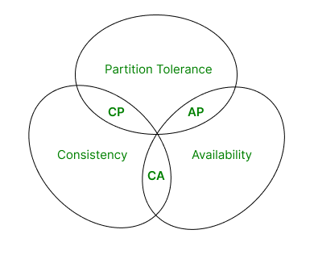
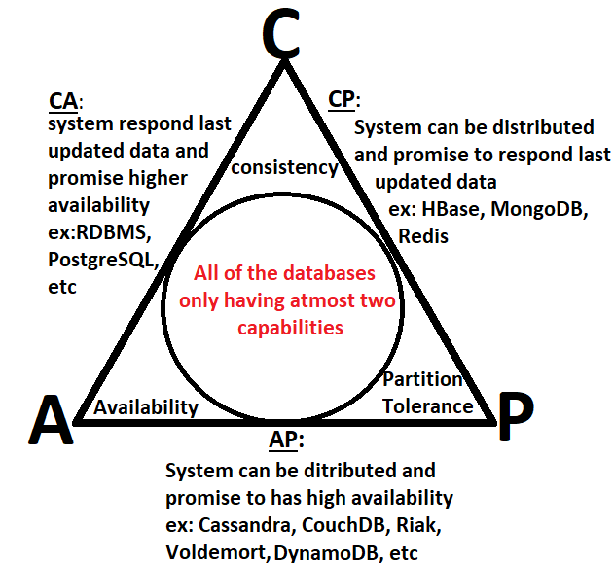
The CAP theorem states that distributed databases can have at most two of the three properties: consistency, availability, and partition tolerance. As a result, database systems prioritize only two properties at a time.
Dept of ISE

Slide 33
The Trade-Offs in the CAP Theorem
CA - These types of system always accept the request to view or modify the data sent by the user and they are always responded with data which is consistent among all the database nodes of a big, distributed network.
AP - These types of system are distributed in nature, ensuring that the request sent by the user to view or modify the data present in the database nodes are not dropped and are processed in presence of a network partition.
CP - These types of system are distributed in nature, ensuring that the request sent by the user to view or modify the data present in the database nodes are dropped instead of responding with inconsistent data in presence of a network partition.
Dept of ISE

Slide 34
The CAP Theorem - Conclusion
The CAP theorem provides a framework for understanding the trade-offs in designing distributed systems. It highlights that only two out of three properties—Consistency, Availability, and Partition Tolerance—can be achieved simultaneously. Depending on the application requirements, developers must prioritize the properties that best meet their needs. It’s also important to note that many modern databases offer configurations to balance these properties dynamically based on specific use cases.
Dept of ISE

Slide 35
Relaxing Durability - A failure of replication durability occurs when a node processes an update but fails before that update is replicated to the other nodes.
A simple case of this may happen if you have a master-slave distribution model where the slaves appoint a new master automatically should the existing master fail.
If a master does fail, any writes not passed onto the replicas will effectively become lost.
Should the master come back online, those updates will conflict with updates that have happened since.
We think of this as a durability problem because you think your update has succeeded since the master acknowledged it, but a master node failure caused it to be lost.
Dept of ISE

Slide 36
Quorums - the minimum number of nodes that must respond to a read or write operation in order for it to be considered complete.
Write quorum: W > N/2, meaning the number of nodes participating in the write (W) must be more than the half the number of nodes involved in replication (N).
Replication factor (N): The number of replicas.
Read quorum : R + W > N, it depends on how many nodes need to confirm a write. This relationship between the number of nodes you need to contact for a read (R), those confirming a write (W), and the replication factor (N) can be captured in an in equality.
How many nodes need to be involved to get strong consistency?
Strong Consistency : W=N
Eventual consistency: W<N
Dept of ISE

Slide 37
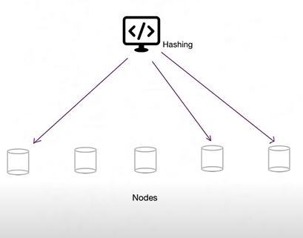
To always be a consistent, following condition must be satisfied:
Read quorum + Write quorum > Replication factor
Example: Replication factor= 3
If we wish Write operation to be fast :
Write quorum: 1
Read quorum : 3
If we wish Read operation to be fast :
Write quorum: 3
Read quorum : 1
Dept of ISE

Slide 38
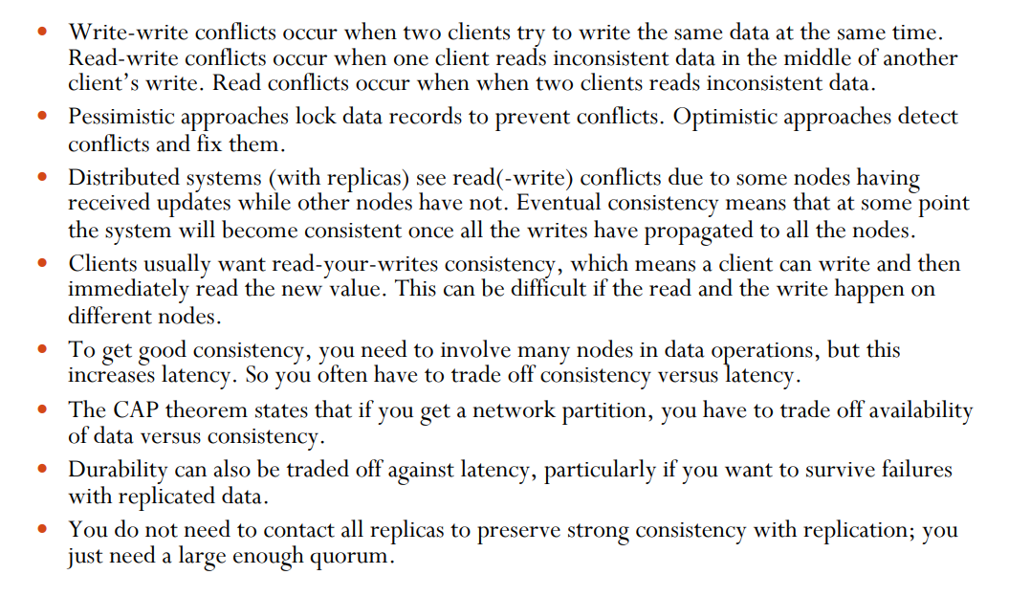
Key Points
The CAP theorem provides a framework for understanding the trade-offs in designing distributed systems. It highlights that only two out of three properties—Consistency, Availability, and Partition Tolerance—can be achieved simultaneously. Depending on the application requirements, developers must prioritize the properties that best meet their needs. It’s also important to note that many modern databases offer configurations to balance these properties dynamically based on specific use cases.
Dept of ISE

Slide 39
Chapter 6 : Version Stamps
A field that changes every time the underlying data in the record changes.
When you read the data you keep a note of the version stamp, so that when you write data you can check to see if the version has changed.
Dept of ISE

Slide 40
Version Stamp helps to detect concurrency conflicts - when you read data, then update it, you can check the version stamp to ensure nobody updated the data between read and write.
Version stamps can be implemented using Counters, GUIDs, Content hashes, timestamps or a combination of these.
With distributed systems, a Vector of version stamps allows you to detect when different nodes have conflicting updates.
A business transaction is an event involving an interchange of goods, money or services between two or more parties.
The transaction can be as brief as a cash purchase or as long lasting as a service contract extending over years.
The business transaction can be between two parties engaged in the business and conducting the transaction for their mutual benefits or between a business entity like retail shop and a customer.
Dept of ISE

Slide 41
Business and System Transactions
A business transaction may be something like browsing a product catalog, choosing a bottle of Talisker at a good price, filling in credit card information, and confirming the order.
The system transaction provided by the database because this would mean locking the database.
Usually applications only begin a system transaction at the end of the interaction with the user, so that the locks are only held for a short period of time.
There are various ways to construct version stamps :
Using Counters
Creating a GUID
Using hash key
Using timestamp
Dept of ISE

Slide 42
Approach 1 : Use a counter, always incrementing it when we update the resource.
Advantage : Counters are useful since they make it easy to tell if one version
is more recent than another.
Disadvantage: they require the server to generate the counter value, and also
need a single master to ensure the counters aren’t duplicated.
Approach 2 : creating a GUID, large random number that’s guaranteed to be unique. These use some combination of dates, hardware information, and whatever other sources of randomness they can pick up
Advantage : The nice thing about GUIDs is that they can be generated by anyone and will never get a duplicate.
Disadvantage : they are large and can’t be compared directly for recentness.
Dept of ISE

Slide 43
Approach 3 : With a big enough hash key size, a content hash can be globally unique like a GUID and can also be generated by anyone.
Advantage : any node will generate the same content hash for same resource data.
Disadvantage: However, like GUIDs they can’t be directly compared for recentness, and they can be lengthy.
Approach 2 : Use the timestamp of the last update. Like counters, they are reasonably short and can be directly compared for recentness.
Advantage : Multiple machines can generate timestamps—but to work properly, their clocks have to be kept in sync.
Disadvantage : One node with a bad clock can cause all sorts of data corruptions. it’s no good using timestamps of a millisecond precision if you get many updates per millisecond.
Dept of ISE

Slide 44
Version Stamps on Multiple Node
The basic version stamp works well when you have a single authoritative source for data, such as a single server or master-slave replication. In that case the version stamp is controlled by the master. Any slaves follow the master’s stamps.
In a peer-to-peer distribution model because there’s no longer a single place to set the version stamps. If you’re asking two nodes for some data, you run into the chance that they may give you different answers.
It may be that an update has only reached one node but not the other and it leads to inconsistent update.
The simplest form of version stamp is a counter. Each time a node updates the data, it increments the counter and puts the value of the counter into the version stamp.
In multiple-masters distributed version control systems ensure that all nodes contain a history of version stamps.
Dept of ISE

Slide 45
Version Stamps on Multiple Nodes
This would either require the clients to hold onto version stamp histories, or the server nodes to keep version stamp histories.
This also detects an inconsistency, which we would see if we get two version stamps and neither of them has the other in their histories.
If we go with timestamp, it’s usually difficult to ensure that all the nodes have a consistent notion of time, particularly if updates can happen rapidly.
So it would only work well for the single-master case.
The most common approach used by peer-to-peer NoSQL systems is a special form of version stamp which we call a vector stamp.
A vector stamp is a set of counters, one for each node.
Dept of ISE

Slide 46
A vector stamp for three nodes (blue, green, black) would look something like [blue: 43, green: 54, black: 12].
Each time a node has an internal update, it updates its own counter, so an update in the green node would change the vector to [blue: 43, green: 55, black: 12].
Whenever two nodes communicate, they synchronize their vector stamps.
If one version stamp is newer than another because the newer stamp will have all its counters greater than or equal to those in the older stamp. So [blue: 1, green: 2, black: 5] is newer than [blue:1, green: 1, black 5] since one of its counters is
greater.
If both stamps have a counter greater than the other, e.g. [blue: 1, green: 2, black: 5] and [blue: 2, green: 1, black: 5], then you have a write-write conflict.
There may be missing values in the vector, in which case we use treat the missing value as 0. So [blue: 6, black: 2] would be treated as [blue: 6, green: 0, black: 2]. This allows you to easily add new nodes without invalidating the existing vector stamps.
Dept of ISE

Slide 47

Dept of ISE

